Slide 1
Unit 9
Teacher: Iddo Sadeh

Slide 2
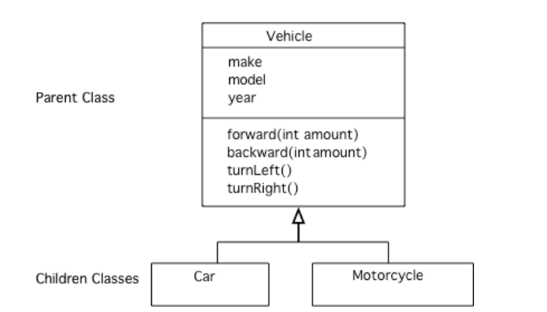
inheritance
*taken from https://csawesome.runestone.academy/runestone/books/published/csawesome/Unit9-Inheritance/topic-9-1-inheritance-day1.html
Notes:
n Java all classes can inherit attributes (instance variables) and behaviors (methods) from another class. The class being inherited from is called the parent class or superclass. The class that is inheriting is called the child class or subclass.

Slide 3
Subclass extends superclass
*taken from https://csawesome.runestone.academy/runestone/books/published/csawesome/Unit9-Inheritance/topic-9-1-inheritance-day1.html
Notes:
To make a subclass inherit from a superclass, use the Java keyword extends with the superclass name when creating a new subclass as shown below.
While a person can have two parents, a Java class can only inherit from one parent class. If you leave off the extends keyword when you declare a class then the class will inherit from the Object class that is already defined in Java.

Slide 4
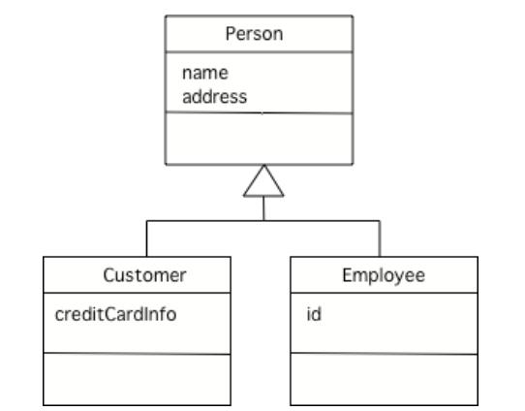
Why inheritance
*taken from https://csawesome.runestone.academy/runestone/books/published/csawesome/Unit9-Inheritance/topic-9-1-inheritance-day1.html
Notes:
Inheritance allows you to reuse data and behavior from the parent class. If you notice that several classes share the same data and/or behavior, you can pull that out into a parent class. This is called generalization. For example, Customers and Employees are both people so it makes sense use the general Person class as seen below.
Question 1
Inheritance is also useful for specialization which is when you want most of the behavior of a parent class, but want to do at least one thing differently and/or add more data. The example below can also be seen as specialization. An employee is a person but also has a unique id. A customer is a person, but also has a credit card.

Slide 5
Is-a vs has-a
In Java, we can reuse our code using an Is-A relationship or using a Has-A relationship. An Is-A relationship is also known as inheritance and a Has-A relationship is also known as composition in Java.
*taken from https://www.c-sharpcorner.com/UploadFile/3614a6/is-a-and-has-a-relationship-in-java/
Notes:
For example, a Potato is a vegetable, a Bus is a vehicle, a Bulb is an electronic device and so on. One of the properties of inheritance is that inheritance is unidirectional in nature. Like we can say that a house is a building. But not all buildings are houses. We can easily determine an Is-A relationship in Java. When there is an extends or implement keyword in the class declaration in Java, then the specific class is said to be following the Is-A relationship.
Question 2 and 3

Slide 6
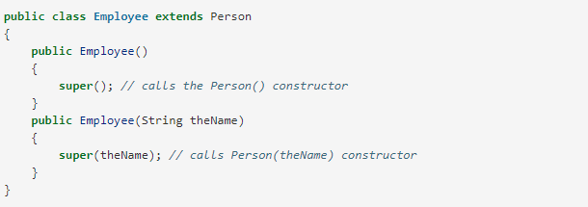
Inheritance and Constructors
*taken from https://csawesome.runestone.academy/runestone/books/published/csawesome/Unit9-Inheritance/topic-9-2-constructors.html
Notes:
Subclasses inherit public methods from the superclass that they extend, but they cannot access the private instance variables of the superclass directly and must use the public accessor and mutator methods. And subclasses do not inherit constructors from the superclass.
Question 4
So, how do you initialize the superclass’ private variables if you don’t have direct access to them in the subclass?

Slide 7
If a class has no constructor in Java, the compiler will add a no-argument constructor. A no-argument constructor is one that doesn’t have any parameters, for example public Person().
If a subclass has no call to a superclass constructor using super as the first line in a subclass constructor then the compiler will automatically add a super() call as the first line in a constructor. So, be sure to provide no-argument constructors in parent classes or be sure to use an explicit call to super() as the first line in the constructors of subclasses.
Regardless of whether the superclass constructor is called implicitly or explicitly, the process of calling superclass constructors continues until the Object constructor is called since every class inherits from the Object class.
*taken from https://csawesome.runestone.academy/runestone/books/published/csawesome/Unit9-Inheritance/topic-9-2-constructors.html
Notes:
Question 5

Slide 8

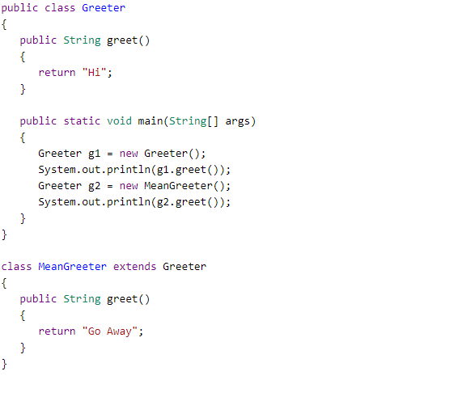
Overriding Methods
*take from https://csawesome.runestone.academy/runestone/books/published/csawesome/Unit9-Inheritance/topic-9-3-overriding.html
Notes:
Overriding an inherited method means providing a public method in a subclass with the same method signature (method name, parameter type list and return type) as a public method in the superclass. The method in the subclass will be called instead of the method in the superclass. One common method that is overriden is the toString() method.

Slide 9
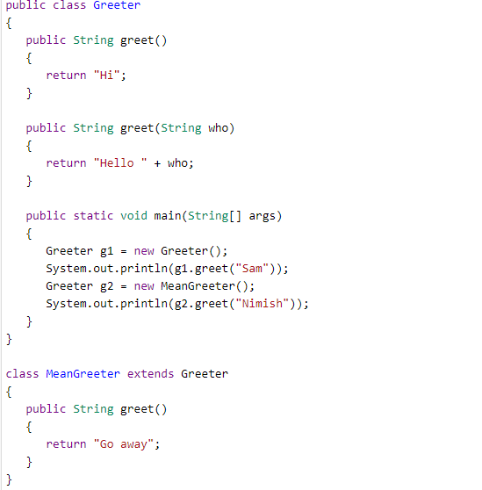

Overloading Methods
Notes:
Don’t get overriding a method confused with overloading a method! Overloading a method is when several methods have the same name but the parameter types, order, or number are different.
Question 7

Slide 10
Inherited Get/Set Methods
https://csawesome.runestone.academy/runestone/books/published/csawesome/Unit9-Inheritance/topic-9-3-overriding.html

Slide 11
super Keyword
super(); or super(arguments); calls just the super constructor if put in as the first line of a subclass constructor.
super.method(); calls a superclass’ method (not constructors)
*taken from https://csawesome.runestone.academy/runestone/books/published/csawesome/Unit9-Inheritance/topic-9-4-super.html
Notes:
https://docs.oracle.com/javase/tutorial/java/IandI/super.html
https://csawesome.runestone.academy/runestone/books/published/csawesome/Unit9-Inheritance/topic-9-4-super.html
9-4-2

Slide 12
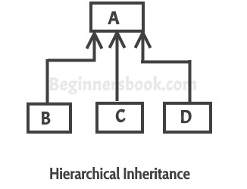
Inheritance Hierarchies
One or more classes can inherit the same class:

Slide 13

Superclass References
*taken from https://csawesome.runestone.academy/runestone/books/published/csawesome/Unit9-Inheritance/topic-9-5-hierarchies.html
Notes:
A superclass reference variable can hold an object of that superclass or of any of its subclasses. For example, a Shape reference variable can hold a Rectangle or Square object. (This is a type of polymorphism which will be defined in the next lesson).
Why?

Slide 14
Polymorphism
https://docs.oracle.com/javase/tutorial/java/IandI/polymorphism.html
Notes:
Question 8

Slide 15
Object Superclass
The parent of all classes.
Inherited by classes if a parent isn’t specified with the extends keyword.
https://docs.oracle.com/javase/tutorial/java/IandI/objectclass.html

